Slide 1
Unveiling Automobile Sales Trends
Name: Hridhthik TP
Mentor: Jaya Pandey

Slide 2
Introduction
This project involves analyzing sales data of miniature automobiles, a popular niche among hobbyists and collectors worldwide.
Tableau’s visualization tools and dashboards are used to explore the data effectively.
The focus is on identifying trends and patterns through exploratory data analysis.
The analysis emphasizes key areas such as sales performance, customer segmentation, and product performance.
The goal is to deliver insights that drive strategic business decisions and improve outcomes.

Slide 3
Objective
Clean and preprocess the dataset to ensure accuracy and consistency for analysis.
Analyze sales performance over a specified period to identify trends and opportunities.
Segment customers based on behaviors, preferences, and purchasing patterns.
Evaluate product performance to highlight high-performing and underperforming items.
Use Tableau dashboards to present insights and inform strategies for sales forecasting and business growth.

Slide 4
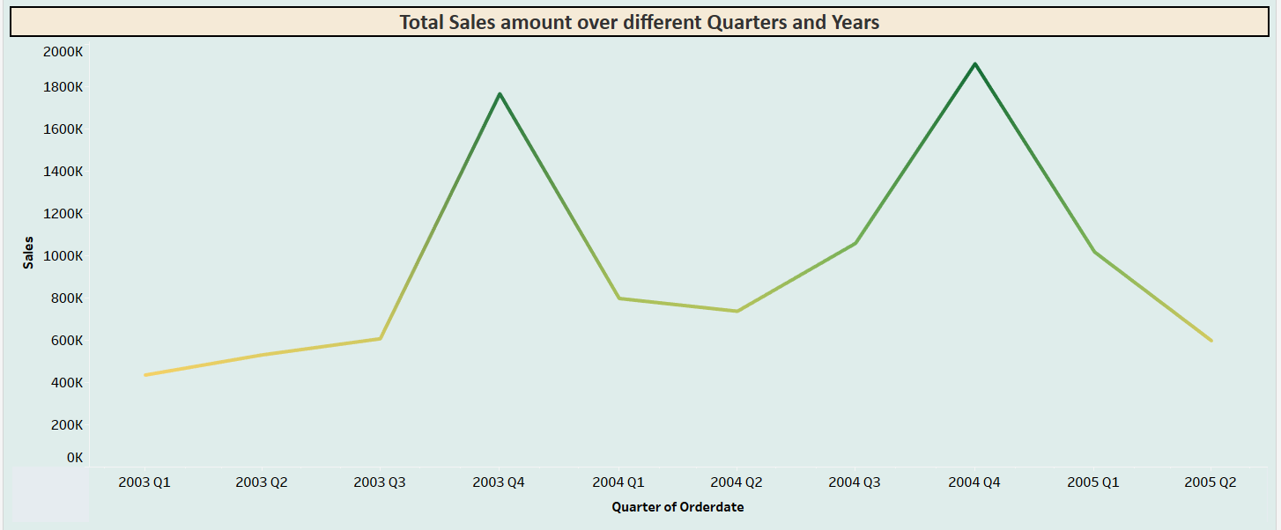
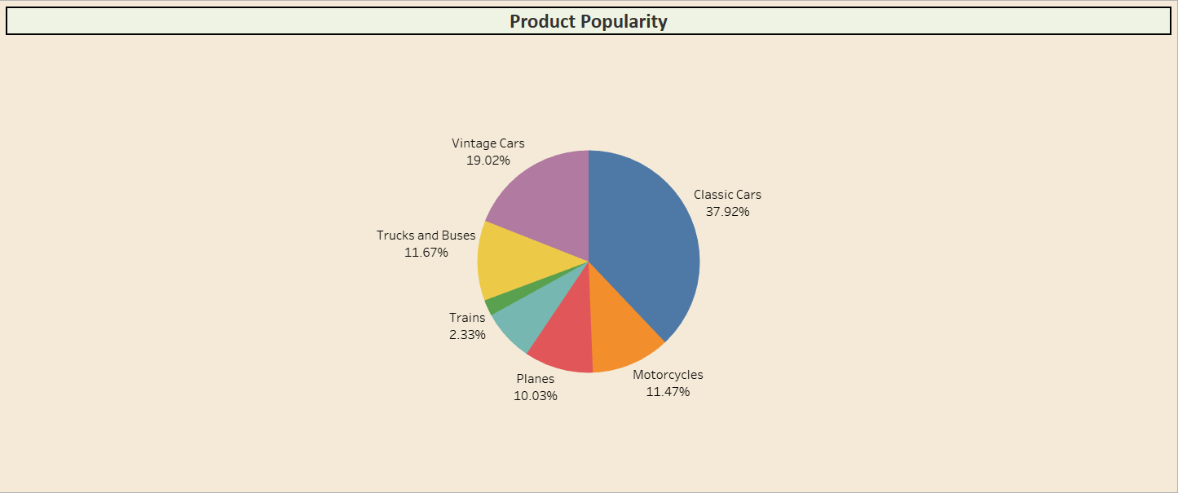
Business related questions
From this graph we can can able to determine 2004 Q4 has highest sales and 2003 Q1 has lowest sales.
From this graph we can see that classic cars contribute most sales than rest of the product line and we can see individual product line contribution.

Slide 5
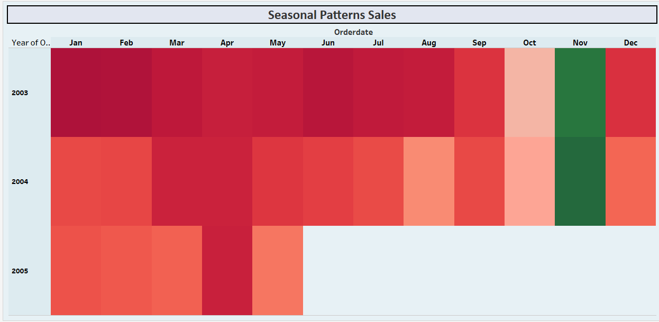
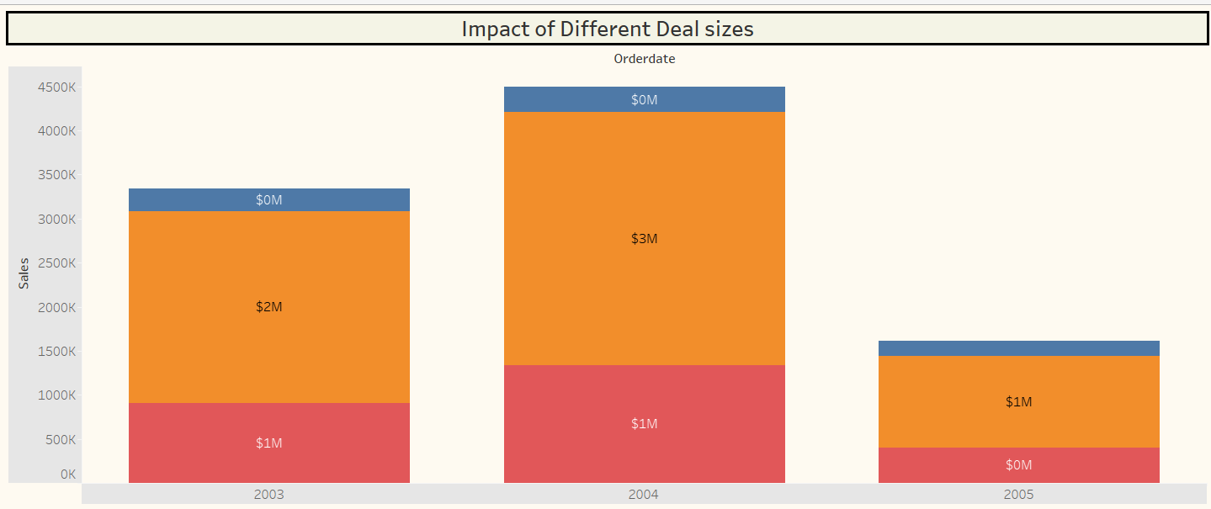
Business related questions
Yes we can able to see the seasonal patterns in sales every year in November month sales was highest.
we can also determine that 2004 has highest sales compared to other years.
In this graph we see impact on Medium deal size are having highest sales in every year.

Slide 6
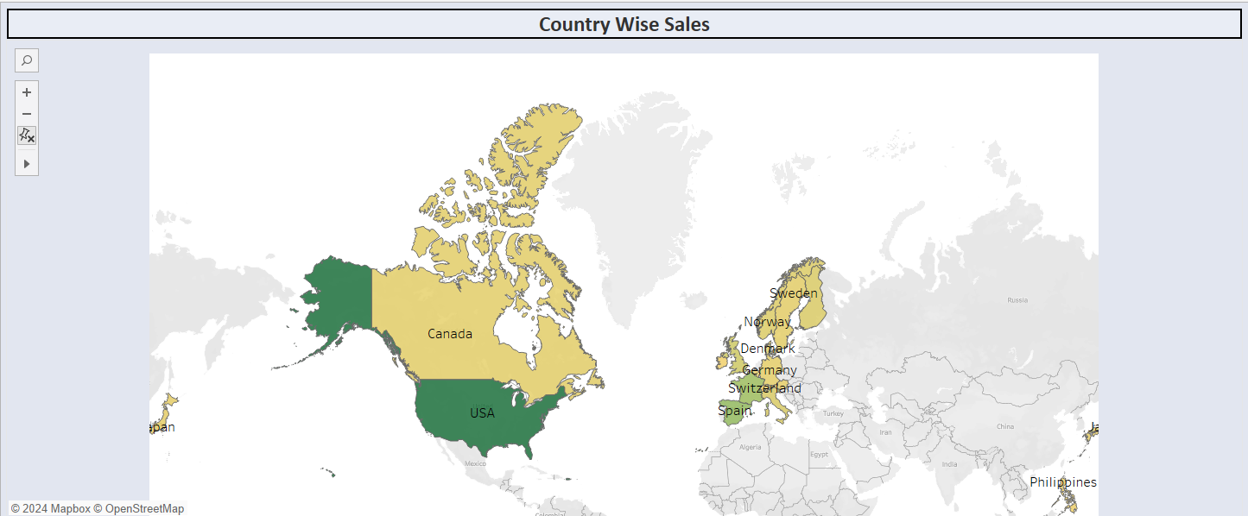
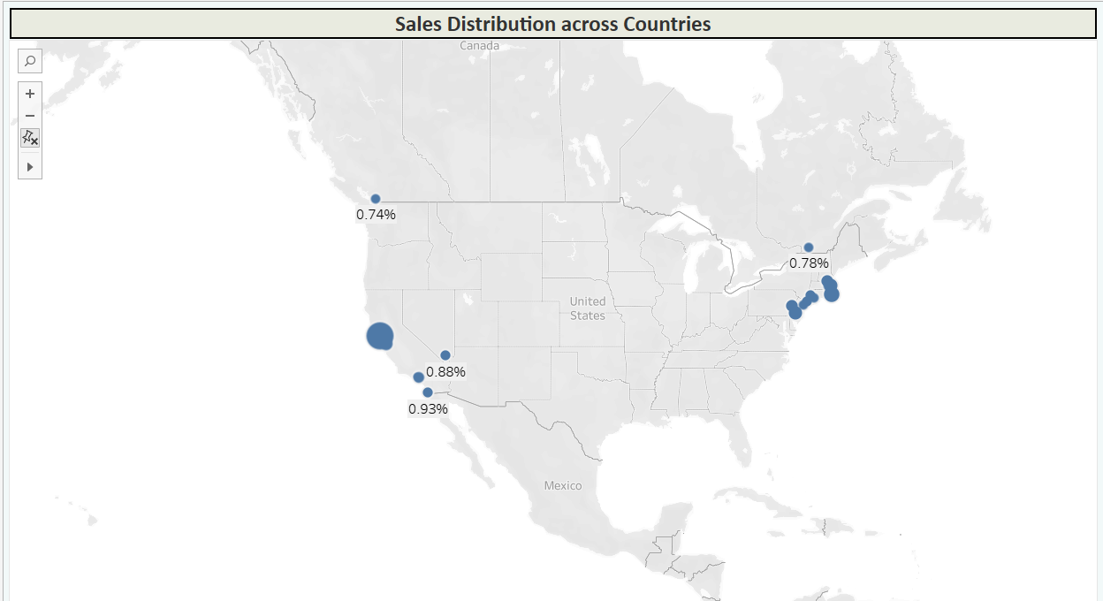
Business related questions
From this graph we can able to determine USA has highest sales in EMEA territory.
Yes we can identify the regional variations in sales based on city and state data.
In USA, the state name is CA and city name is San-rafel has highest customer variation.

Slide 7
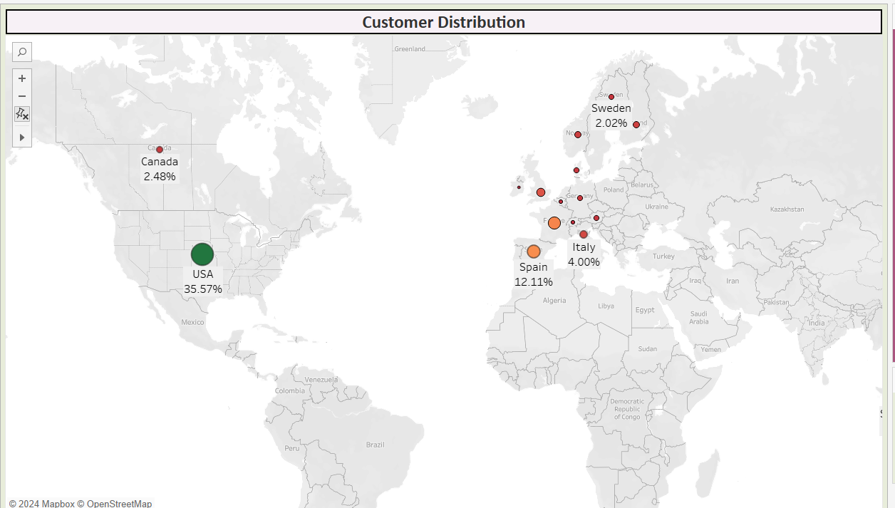
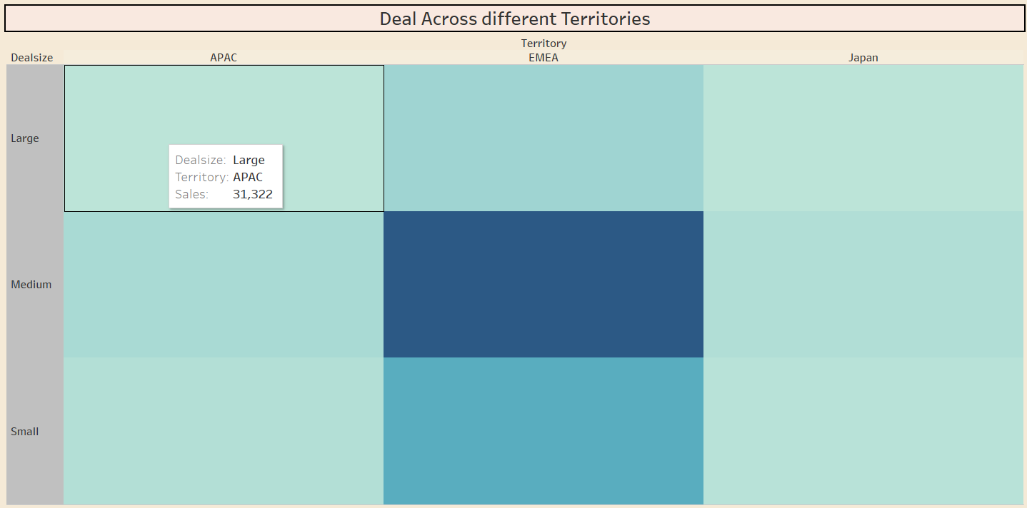
Business related questions
From this graph we can determine the customer distribution for each country and USA has highest distribution of 35.57%
from this we can determine the size of the deal across different territories, hence The medium size owns the largest size in EMEA territory.

Slide 8
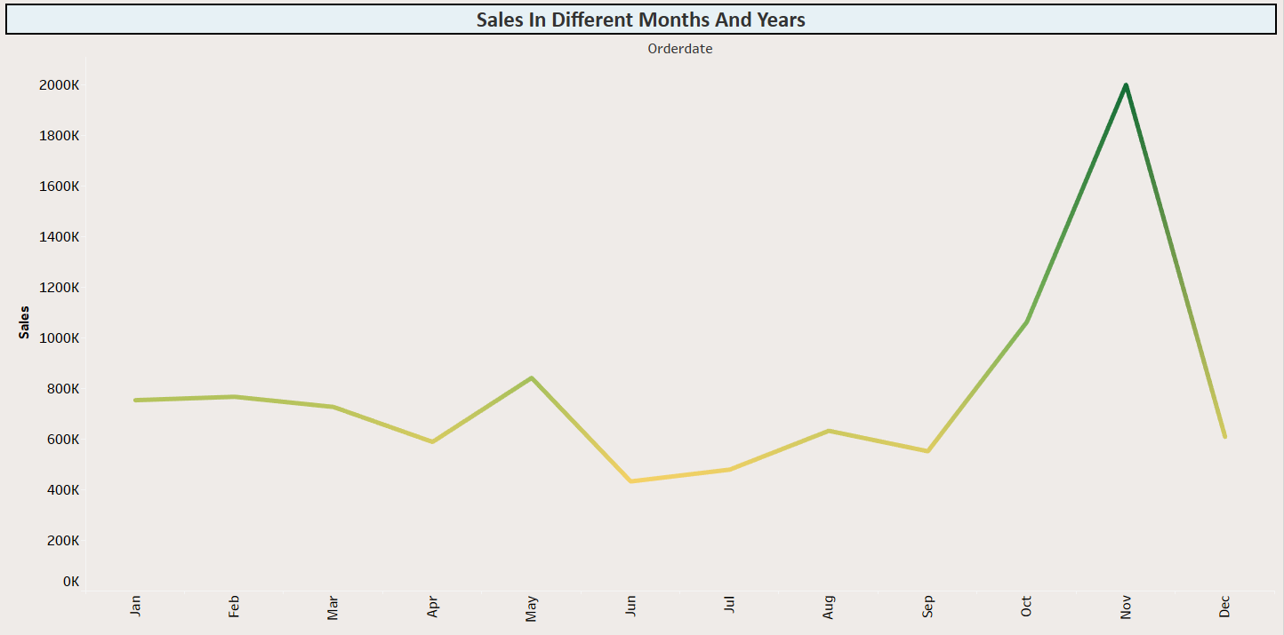
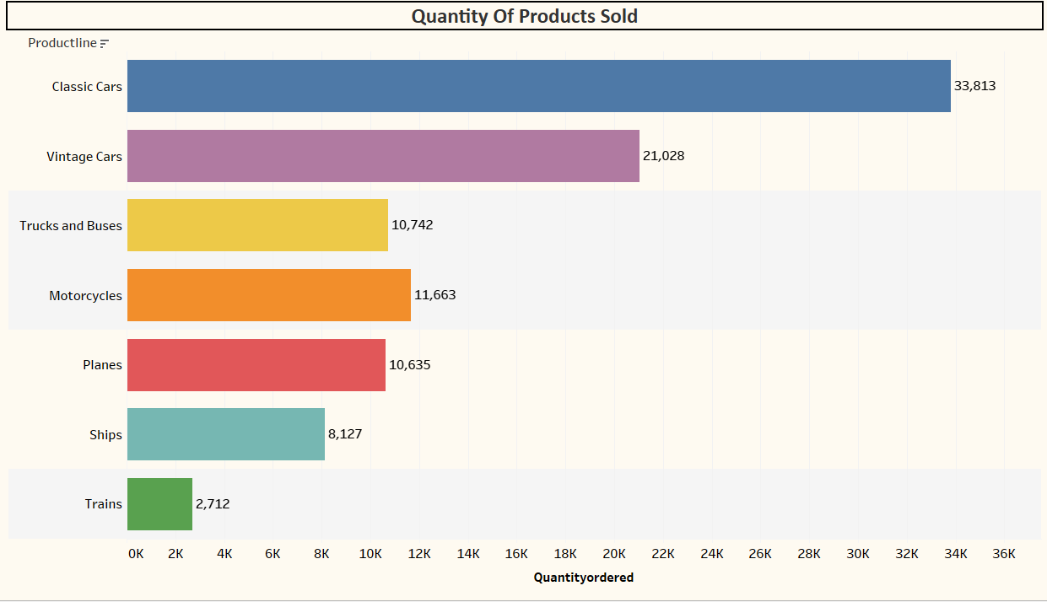
Business related questions
Yes we can identify the seasonality in sales data, at November month each year we can determine the highest sales.
Classic Cars have highest quantities ordered.
Trains have lowest quantities ordered.

Slide 9
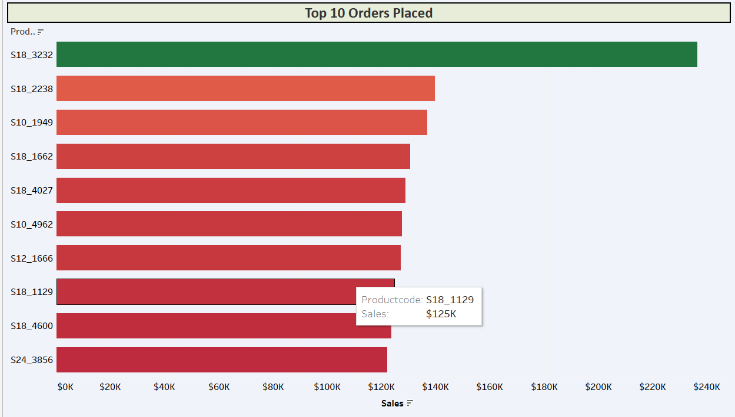
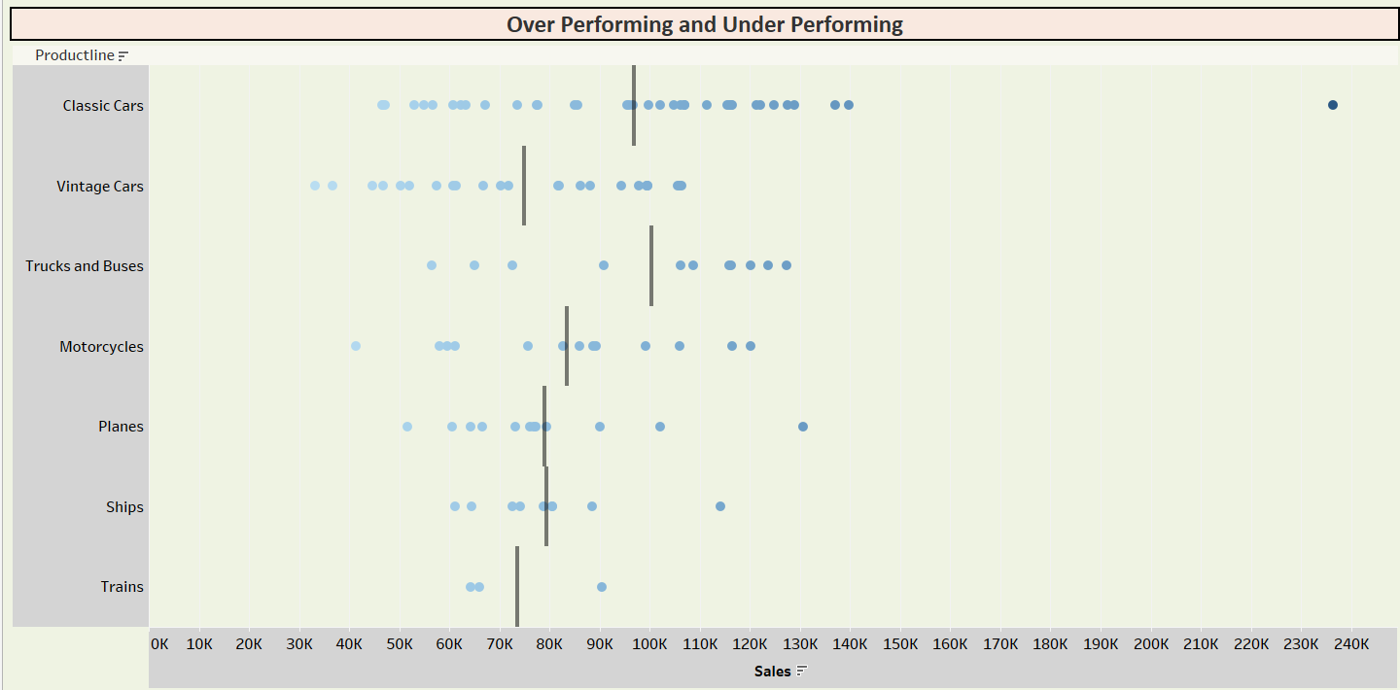
Business related questions
The chart reveals significant variations in sales across different product codes. Some product codes, like S18_3232 and S10_2238, have significantly higher sales compared to others. Additionally, the chart shows that certain product codes belong to the same product line (e.g., Classic Cars), while others belong to different product lines (e.g., Motorcycles, Planes). This suggests that even within the same product line, individual products can have varying levels of sales performance.
We can able to determine the underperforming and overperforming products through dot-strip map.
We can set average line from this we can identify the performances for the produtline.
hence we determine that classicars are overperforming

Slide 10
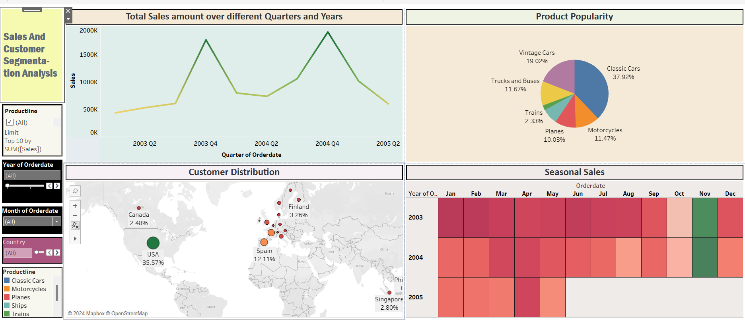
Sales And Customer Segmentation Analysis

Slide 11
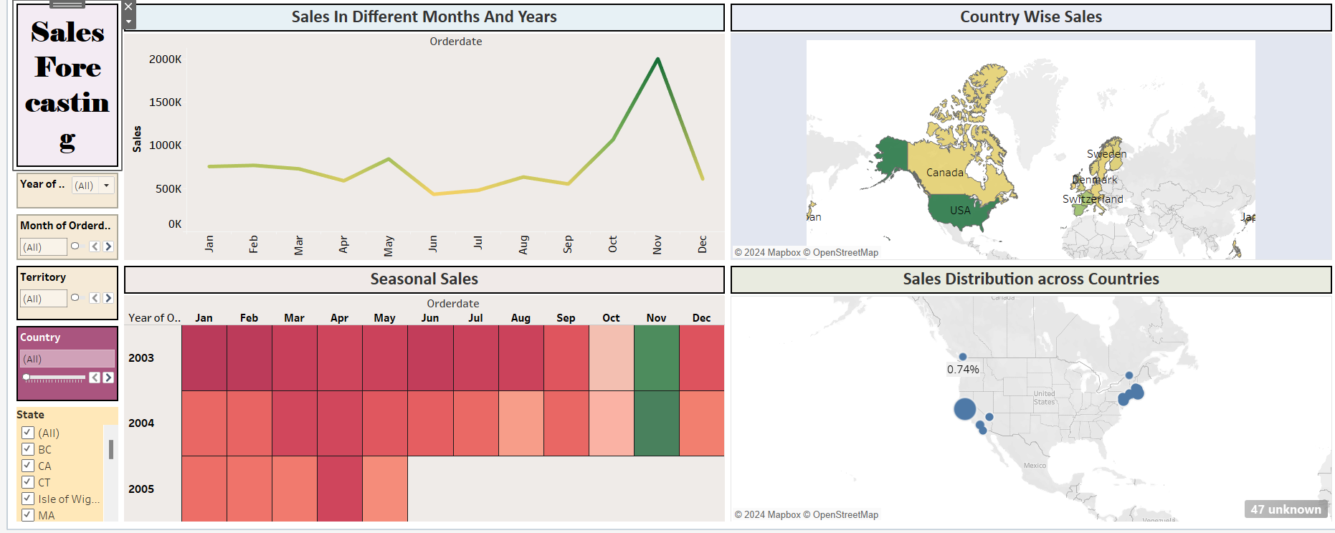
Sales Forecasting Analysis

Slide 12
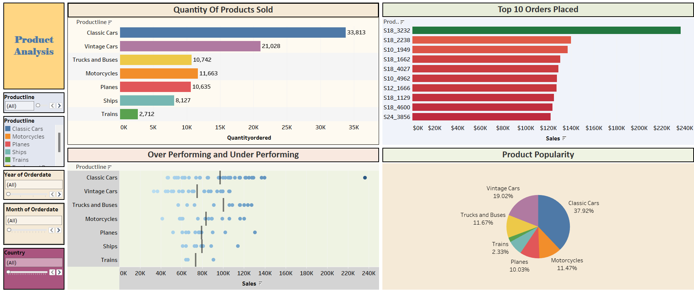
Product Analysis

Slide 13
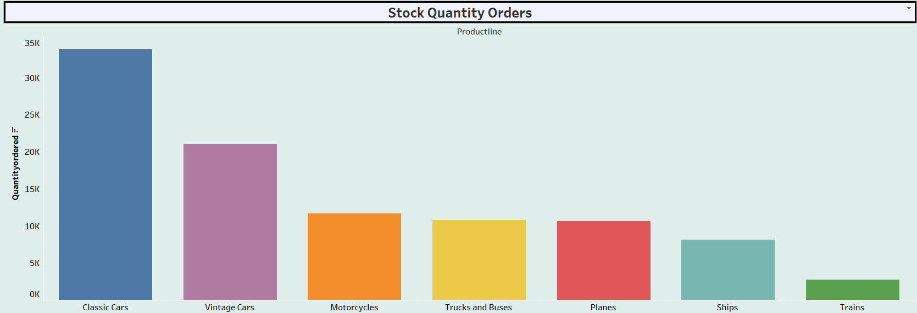
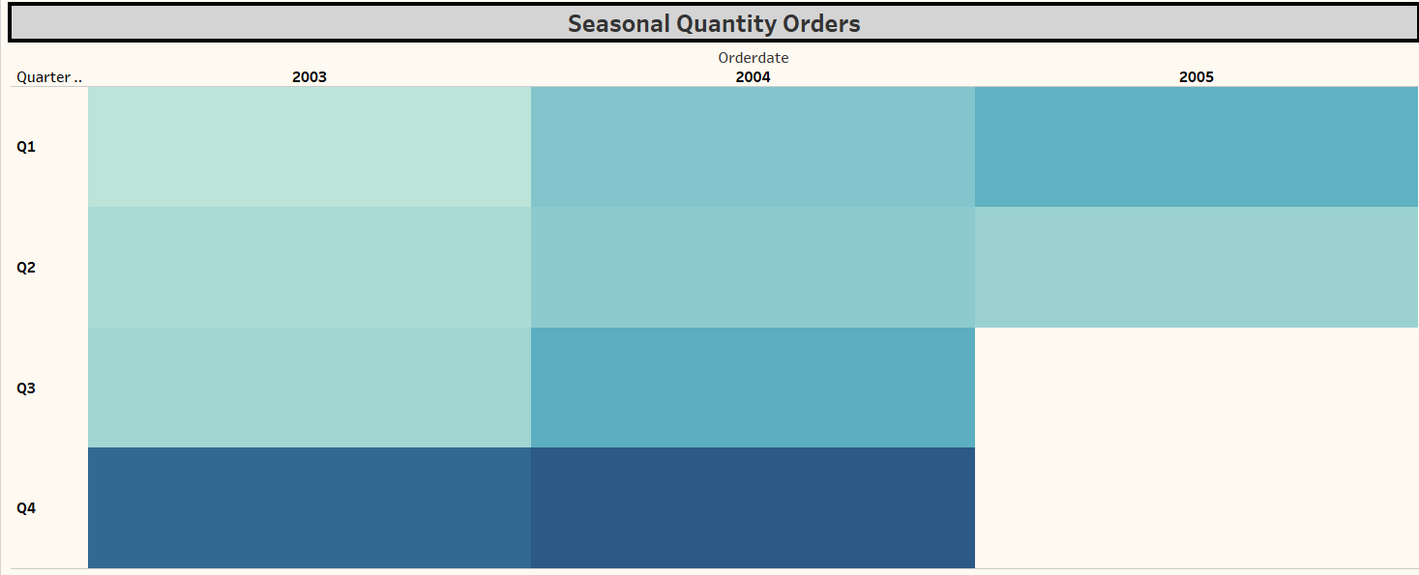
Business related questions
From this graph we can determine the classic cars have highest quantities orders and Trains have lowest quantities orders.
In this graph we can able to determine in the Q4 has highest quantity ordered which helps in optimizing inventory levels.

Slide 14
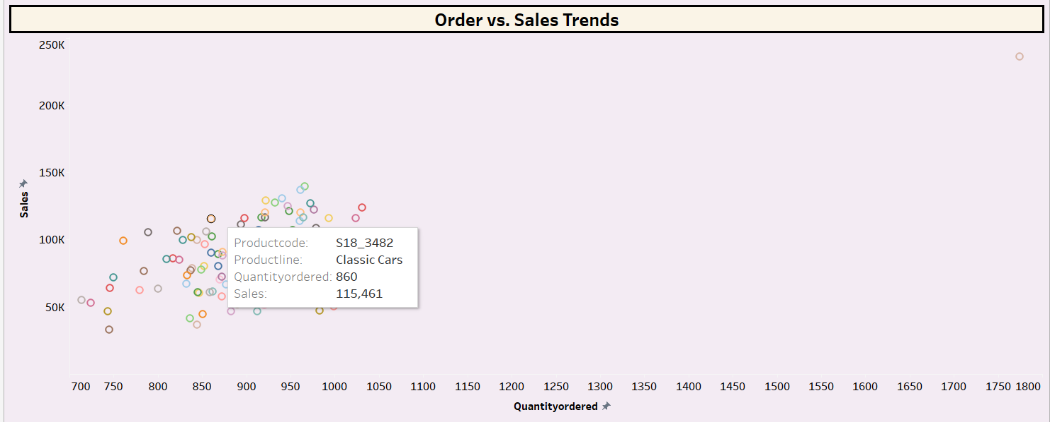
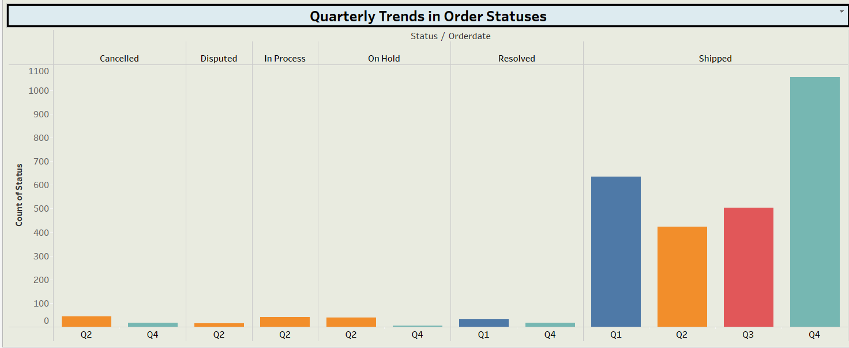
Business related questions
This graph shows the relationship between Sales and QuantityOrdered,in which we can determine the sales and Quantity Ordered for particular product line.
In this graph we can determine the order status of different Quarters, in which shipped status has highest counts.

Slide 15
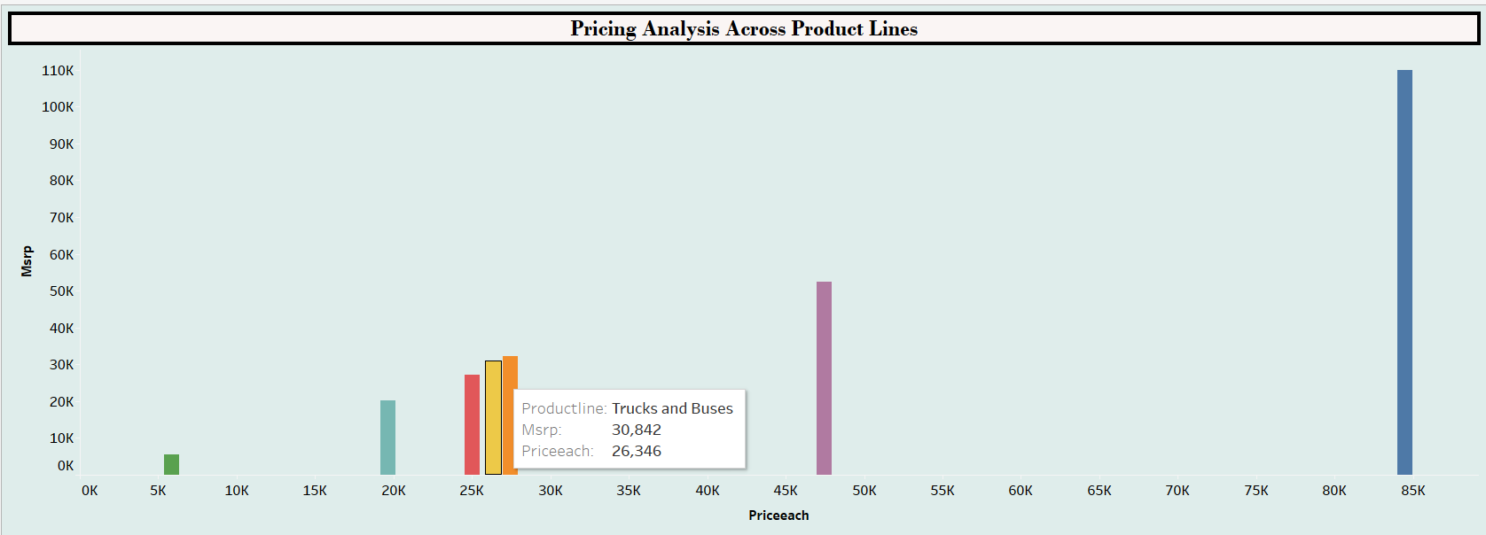
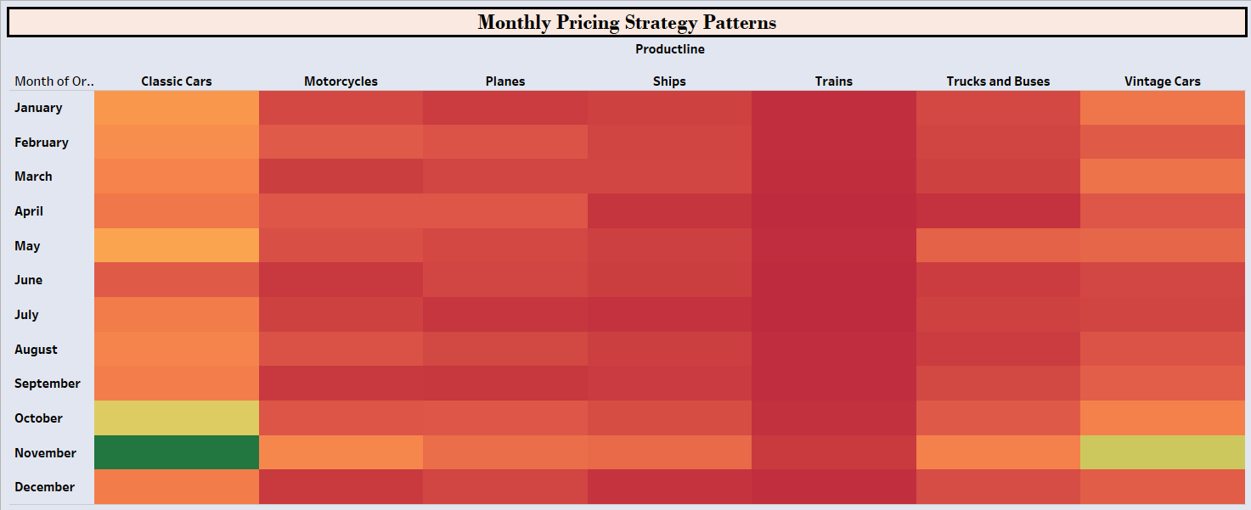
Business related questions
In this graph we have compared the actual price and MSRP price, in which we determine the vintage cars has highest price and Trains have lowest price.
We can able to identify the patterns for product line over months ,in which classic cars have highest price in November month and Tains have lowest price in April.

Slide 16
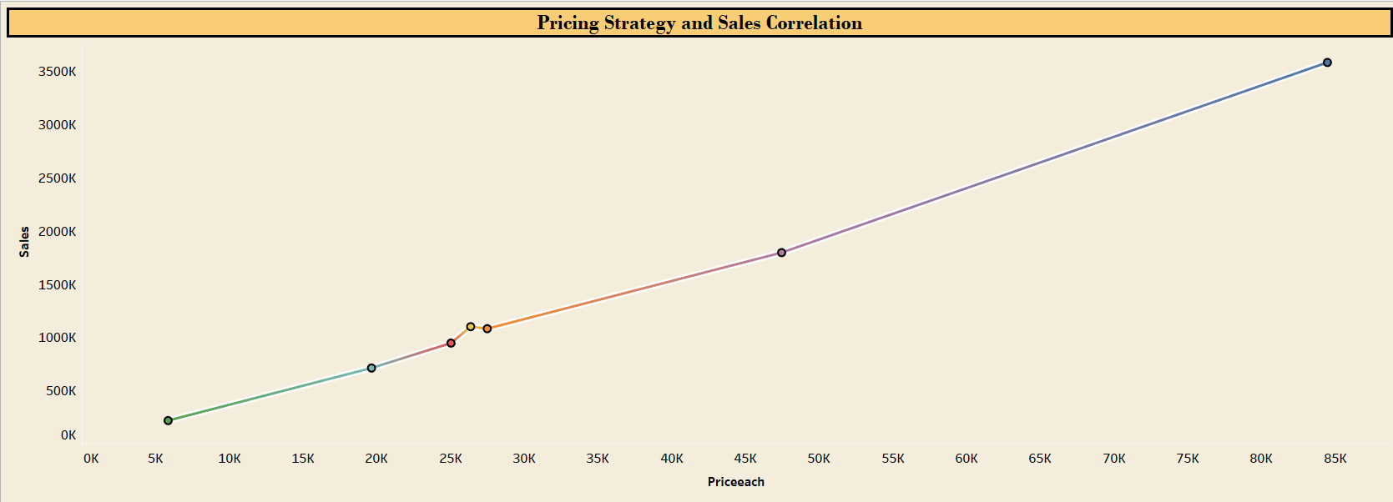
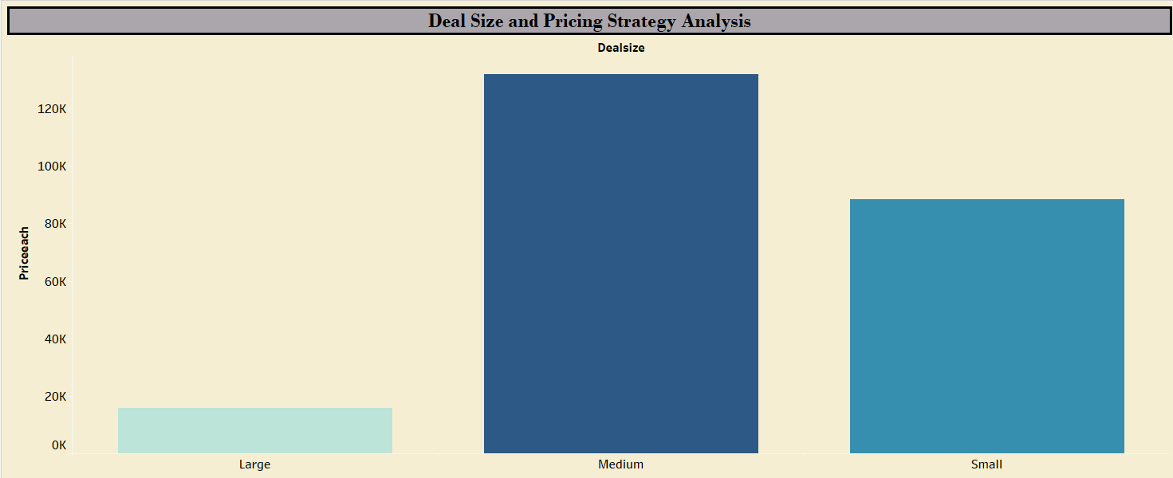
Business related questions
in this graph we can able to determine the relation between sales and price each for all products.
classic cars strong relation because of sales and price each.
In this graph we can determine, Medium size have highest price

Slide 17
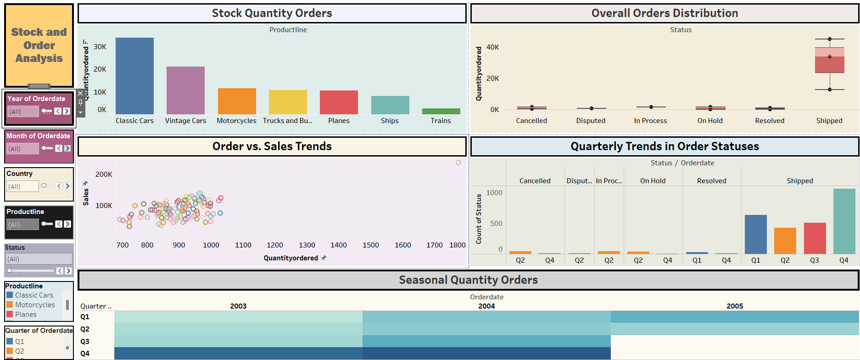
Stock and Order Analysis

Slide 18
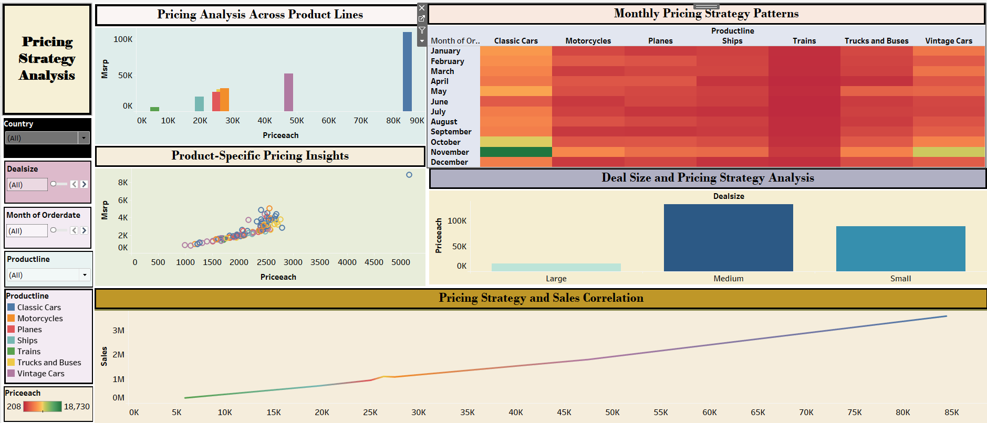
Pricing Strategy Analysis

Slide 19
Summary:
Sales Performance: The company experienced significant growth in 2003-2004, particularly driven by "Classic Cars" and "Vintage Cars." However, a downturn occurred in late 2004 and into 2005.
Product Popularity: "Vintage Cars" and "Classic Cars" are the top-selling product lines, while "Trains" and "Ships" have the lowest demand.
Regional Performance: The USA and Spain are the largest markets, while EMEA has a higher concentration of medium-sized deals compared to APAC and Japan.
Seasonal Trends: Sales exhibit a strong seasonal pattern, peaking in November and December, and declining during summer months.

Slide 20
Summary Continues:
Product Demand: Classic Cars are the most popular product, while Trains are the least popular. There's a seasonal demand pattern, with peak demand in October.
Order Fulfillment: The order fulfillment process is efficient, with most orders shipped on time. However, there was a noticeable increase in order cancellations in Q4.
Pricing Strategy: The company generally sells products below MSRP, with Classic Cars and Trucks/Buses being closer to MSRP. There's a positive correlation between price and quantity ordered for some products, particularly Classic Cars and Vintage Cars.
Deal Size Pricing: The company employs a tiered pricing strategy, with higher prices for larger deals.

Slide 21
Thank You

